Slide 1
Chapter 4: Threads

Slide 2
Chapter 4: Threads
Overview
Multithreading Models
Thread Libraries
Threading Issues
Sections 4.1 – 4.4 of Text Book1

Slide 3
Objectives
To introduce the notion of a thread — a fundamental unit of CPU utilization that forms the basis of multithreaded computer systems
To discuss the APIs for the Pthreads, Win32, and Java thread libraries
To examine issues related to multithreaded programming

Slide 4
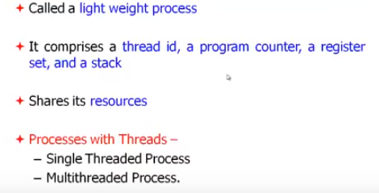

Slide 5
A thread consists of
A Thread id
A program counter
A register set
And a Stack
It shares with other threads belonging to the same process its code section, data section and other operating system resources.

Slide 6
Motivation
Threads run within application
Multiple tasks with the application can be implemented by separate threads
Update display
Fetch data
Spell checking
Answer a network request
Process creation is heavy-weight while thread creation is light-weight
Can simplify code, increase efficiency
Kernels are generally multithreaded

Slide 7
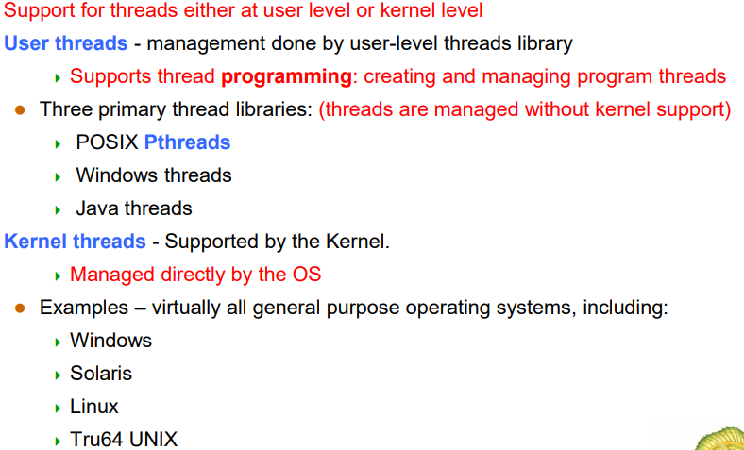

Slide 8
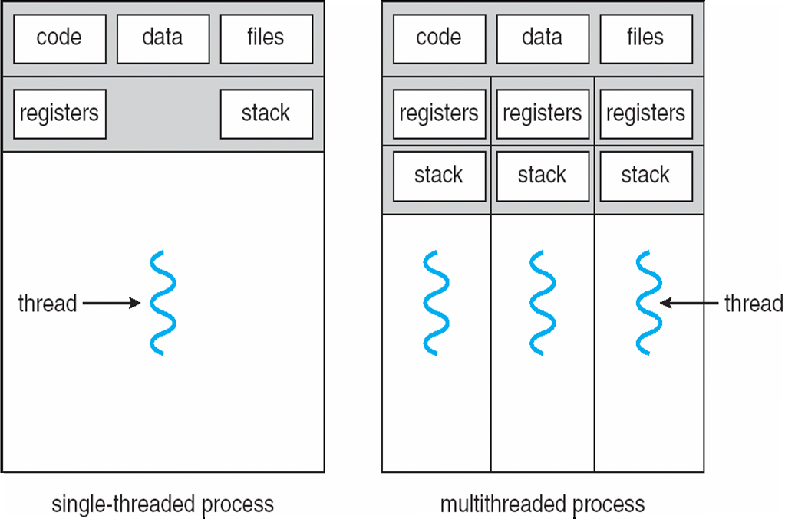
Single and Multithreaded Processes

Slide 9
Thread is a single sequence stream within a process.
Threads have same properties as of the process so they are called as light weight processes.
Threads are executed one after another but gives the illusion as if they are executing in parallel.
Each thread has different states. Each thread has
A program counter
A register set
A stack space

Slide 10
Similarity between Threads and Processes –
Only one thread or process is active at a time
Within process both execute sequential
Both can create children
Differences between Threads and Processes
Threads are not independent, processes are.
Threads are designed to assist each other, processes may or may not do it

Slide 11
Benefits
Responsiveness
Resource Sharing
Economy
Scalability

Slide 12
Benefits
Responsiveness Multithreading an interactive application may allow a program to continue running even if part of it is blocked or is performing a lengthy operation, thereby increasing responsiveness to the user.
Eg. Multi threaded web browser could allow user interaction in one thread while displaying an image by other thread.

Slide 13
Benefits
Resource Sharing
Processes may share resources by means of message passing or shared mem

Slide 14
Benefits
Economy
allocation of memory and resources for process creation is costly. Because threads share resources of the process to which they belong t, it is more economical to create and context-switch thread.
Creating a process is thirty times slower than creating a thread. And context-switching is 5 times slower.

Slide 15
Benefits
Scalability
The benefits of multiprog can be greatly increased in a multiprocessor architecture, where threads may be running in parallelon different multiprocessors.
A single threaded process can only run on one processor , regardless how many are available.
Multithreading on a Multi CPU machine increases ______________

Slide 16
Benefits
Scalability
The benefits of multiprogram can be greatly increased in a multiprocessor architecture, where threads may be running in parallel on different multiprocessors.
A single threaded process can only run on one processor , regardless how many are available.
Multithreading on a Multi CPU machine increases parallelism

Slide 17
Differentiate between multithreaded and multicore programming?

Slide 18
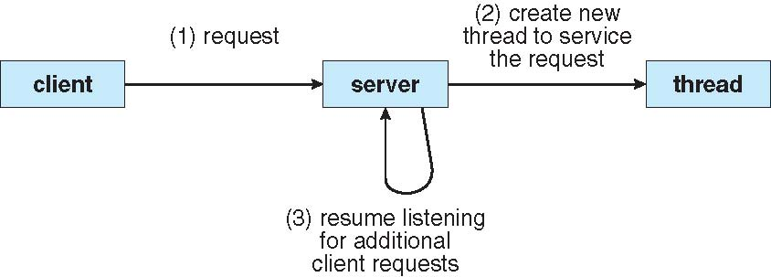
Multithreaded Server Architecture

Slide 19
User Threads
Thread management done by user-level threads library
Three primary thread libraries:
POSIX Pthreads
Win32 threads
Java threads

Slide 20
Kernel Threads
Supported by the Kernel
Examples
Windows XP/2000
Solaris
Linux
Tru64 UNIX
Mac OS X

Slide 21
Multithreading Models
Many-to-One
One-to-One
Many-to-Many

Slide 22
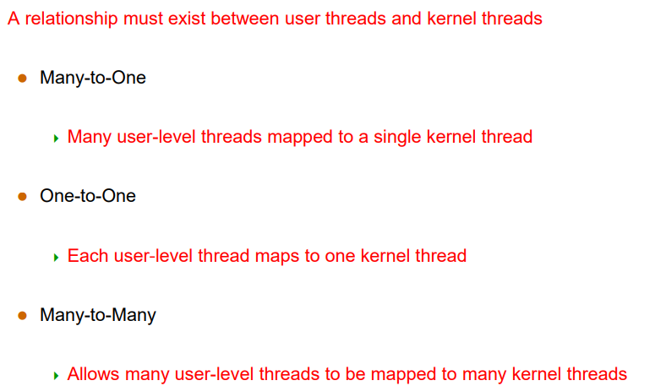

Slide 23
Many-to-One
Many user-level threads mapped to single kernel thread
Examples:
Solaris Green Threads
GNU Portable Threads

Slide 24
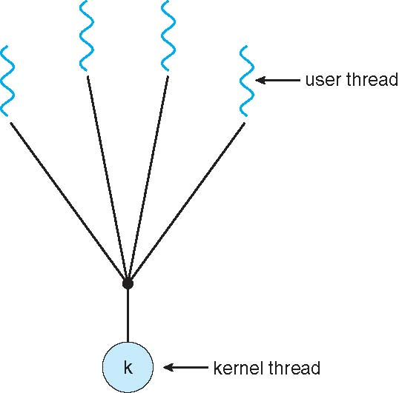
Many-to-One Model

Slide 25
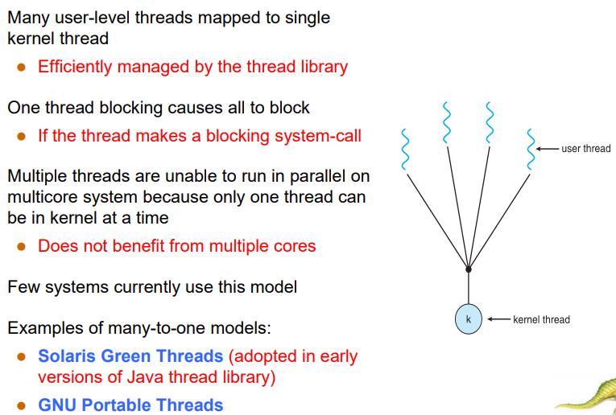

Slide 26
One-to-One
Each user-level thread maps to kernel thread
Examples
Windows NT/XP/2000
Linux
Solaris 9 and later

Slide 27
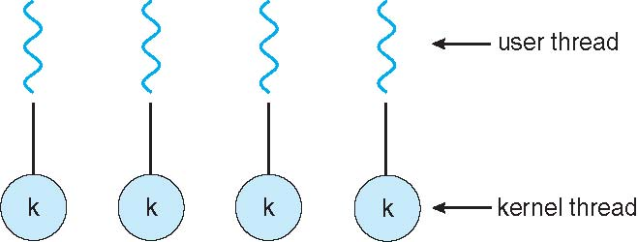
One-to-one Model

Slide 28
What happens when a thread is blocked?
Blocked means execution gets stuck there; generally, the thread is put to sleep by the system and yields the processor to another thread.
When a thread is blocked trying to acquire a mutex, execution resumes when the mutex is released, though thethread might block again if another thread grabs the mutex before it can

Slide 29
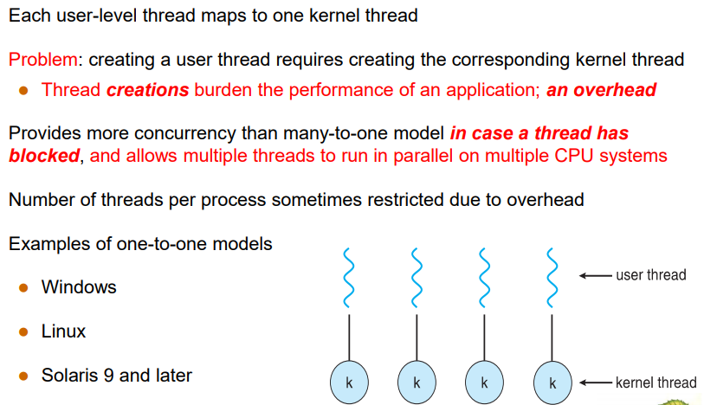

Slide 30
Many-to-Many Model
Allows many user level threads to be mapped to many kernel threads
Allows the operating system to create a sufficient number of kernel threads
Solaris prior to version 9
Windows NT/2000 with the ThreadFiber package

Slide 31
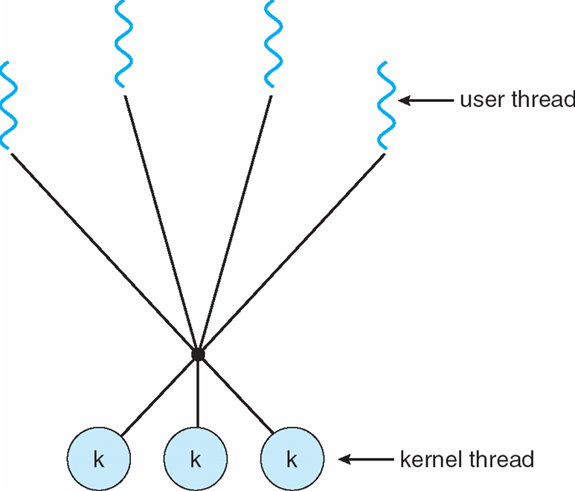
Many-to-Many Model

Slide 32
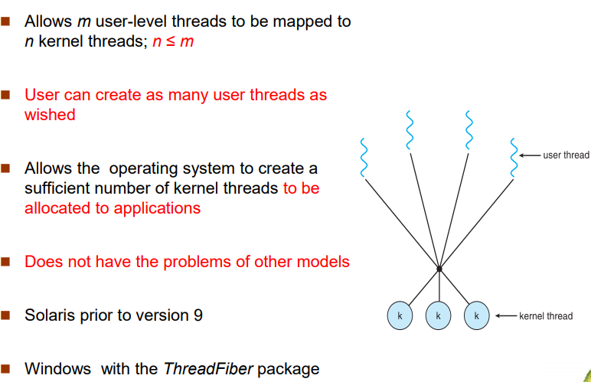

Slide 33
Two-level Model
Similar to M:M, except that it allows a user thread to be bound to kernel thread
Examples
IRIX
HP-UX
Tru64 UNIX
Solaris 8 and earlier

Slide 34
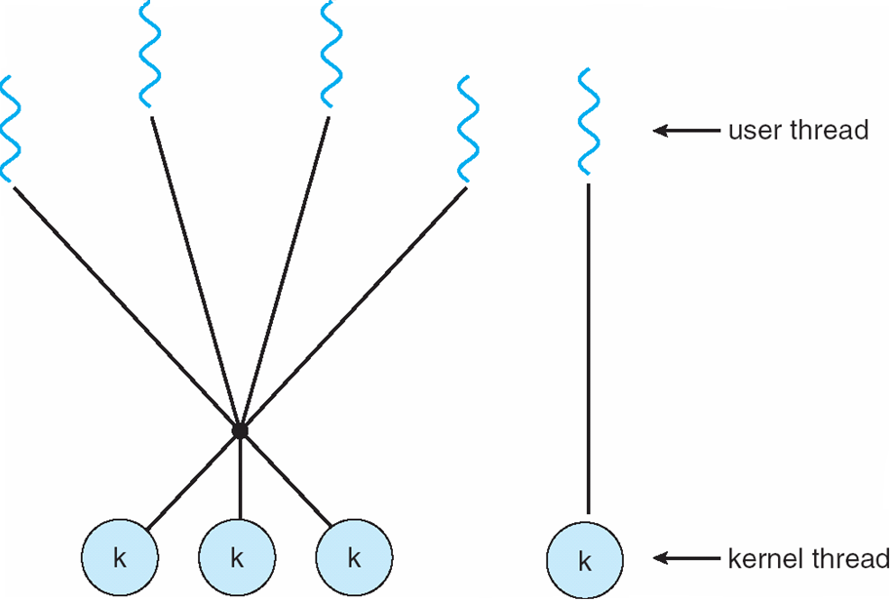
Two-level Model

Slide 35
Multicore Programming
Multicore systems putting pressure on programmers, challenges include:
Dividing activities
Balance
Data splitting
Data dependency
Testing and debugging

Slide 36
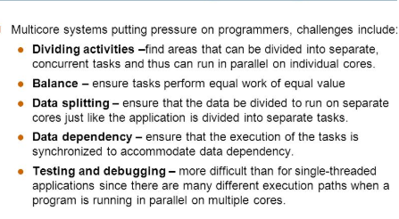

Slide 37
Differentiate between multithreaded and multicore programming?

Slide 38
Multithreaded Server Architecture

Slide 39
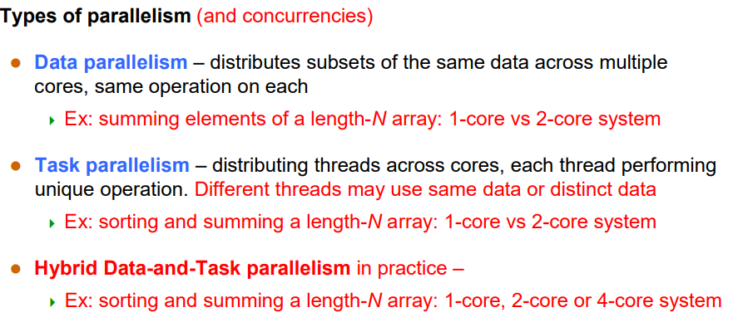

Slide 40
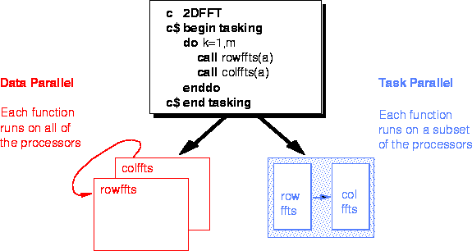
Task parallelism is the simultaneous execution on multiple cores of many different functions across the same or different datasets.
Data parallelism (aka SIMD) is the simultaneous execution on multiple cores of the same function across the elements of a dataset.

Slide 41
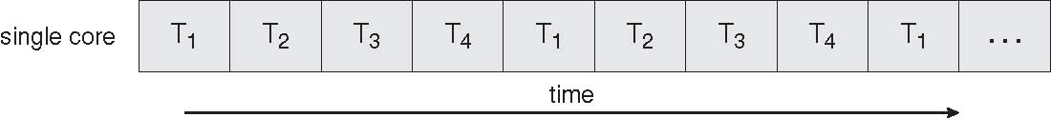
Concurrent Execution on a Single-core System

Slide 42
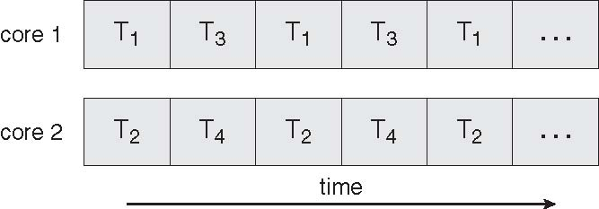
Parallel Execution on a Multicore System

Slide 43
Thread Libraries
Thread library provides programmer with API for creating and managing threads
Two primary ways of implementing
Library entirely in user space
Kernel-level library supported by the OS

Slide 44
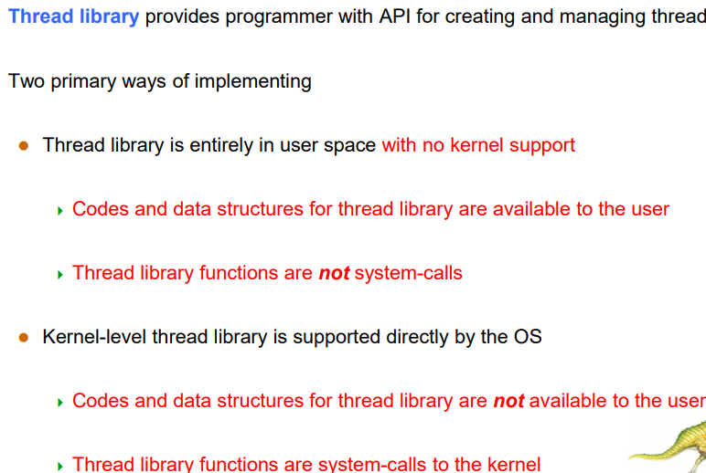

Slide 45
Pthreads
May be provided either as user-level or kernel-level
POSIX Threads. POSIX Threads, usually referred to as pthreads, is an execution model that exists independently from a language, as well as a parallel execution model. ... POSIX Threads is an API defined by the standard POSIX.1c, Threadsextensions (IEEE Std 1003.1c-1995)
A POSIX standard (IEEE 1003.1c) API for thread creation and synchronization
API specifies behavior of the thread library, implementation is up to development of the library
Common in UNIX operating systems (Solaris, Linux, Mac OS X)

Slide 46
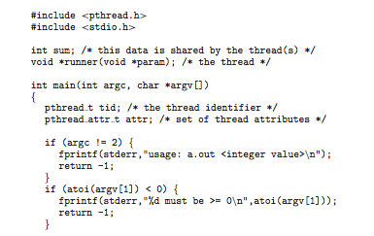
Pthreads Example

Slide 47
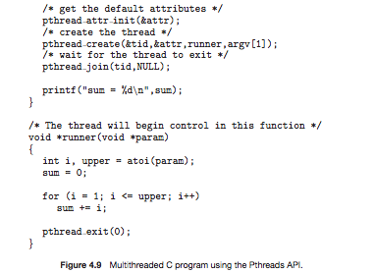
Pthreads Example (Cont.)

Slide 48
End of Chapter 4

